Slide 1
HACKATHON
G10
MEDIGUIDE

Slide 2
OVERVIEW
A user-friendly chatbot that helps users identify potential health issues based on symptoms.
A comprehensive healthcare solution for users to manage their health effectively.
Brief overview of the technology used (e.g., app platforms like iOS/Android, AI for symptom checking, data encryption for security).

Slide 3
KEY FEATURES
Symptom Checker Personalized
Helps users identify potential health conditions based on their symptoms.
Provides actionable suggestions for care or when to seek medical attention.
Personalized Health Insights
Offers tailored recommendations based on user data like age, lifestyle, and medical history.
Tracks health trends over time for better decision-making.

Slide 4
TOOL USED
HTML was used to structure the content and define the layout of the chatbot, ensuring the foundation was robust and accessible.
CSS played a key role in styling the chatbot, adding design elements such as colors, fonts, and animations to enhance user engagement and provide a seamless visual experience.
JavaScript served as the backbone for interactivity, enabling real-time communication, user input handling, and dynamic responses to create a smooth and responsive user experience.

Slide 5
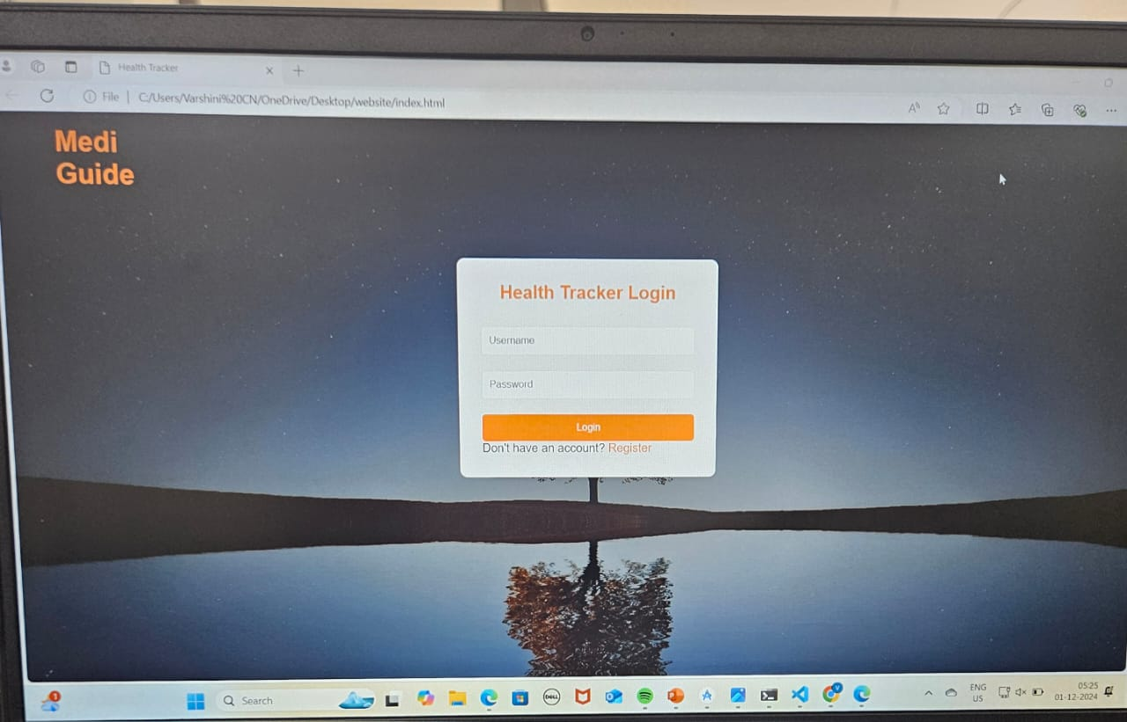
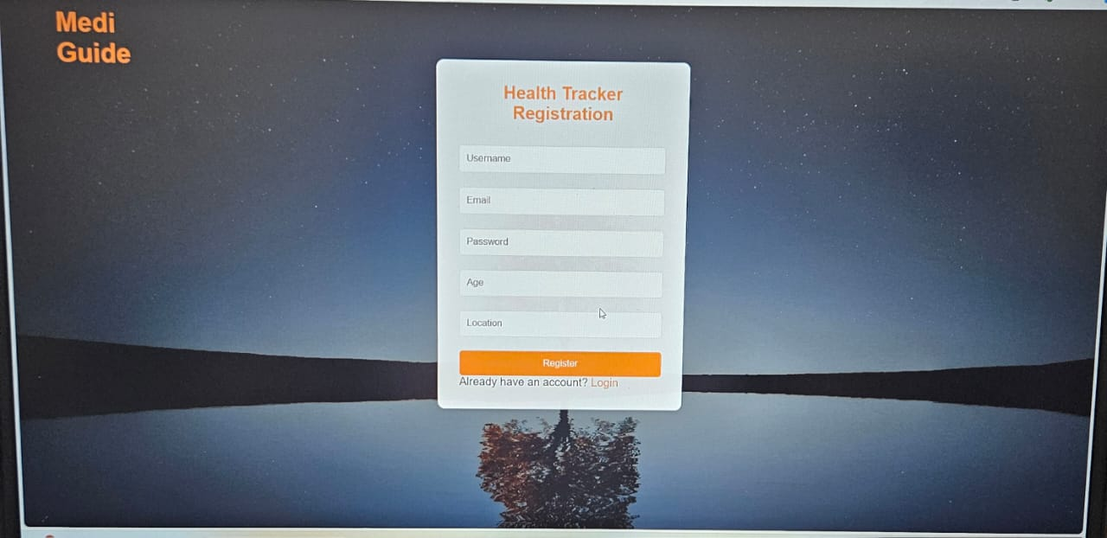
SOLUTIONS

Slide 6
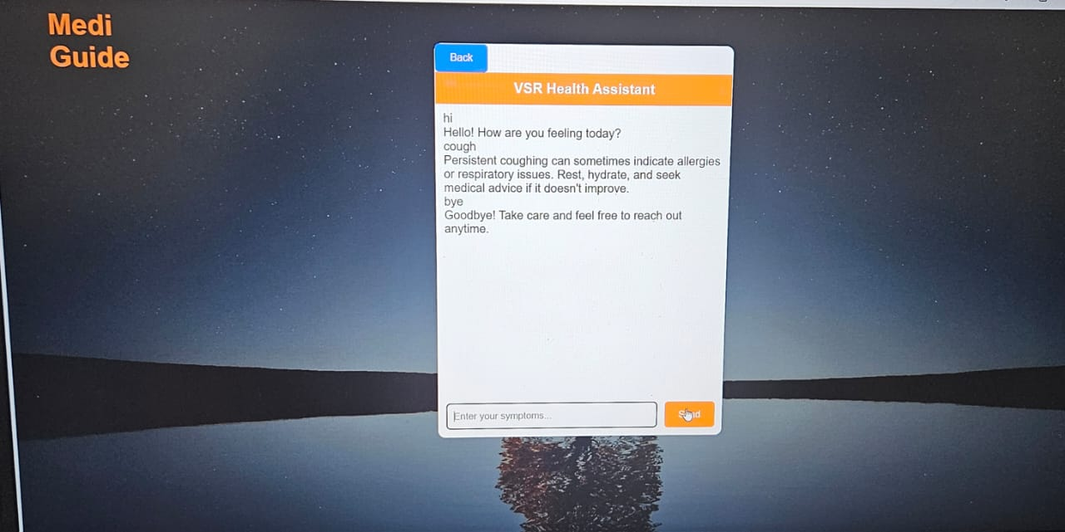
OUTPUT

Slide 7
FUTURE ROADMAP
Upcoming features or expansions:
Integration with wearable devices.
Support for telemedicine.
Multi-language support.
Implementing a symptom checker powered by advance machine leaning algorithms.

Slide 8
CONCLUSION
Mediguide is more than just an website it’s a step forward in transforming how people manage their health. By combining user-friendly design with cutting-edge technology, we aim to make healthcare guidance accessible to everyone.
With our vision of integrating AI-powered features like the symptom checker, we are committed to enhancing the user experience and delivering reliable health solutions.

Slide 9
THANK YOU !!!..
Varshini C N
Rishi H
Sanjana S Gadge
Talanki Varshini
Presented by Tech Titans

